Slide 1
Final project https://www.edituradph.ro/ Student : Alina Panaitescu
Scoala Informala de IT
Software/Manual Testing (QA)

Slide 2
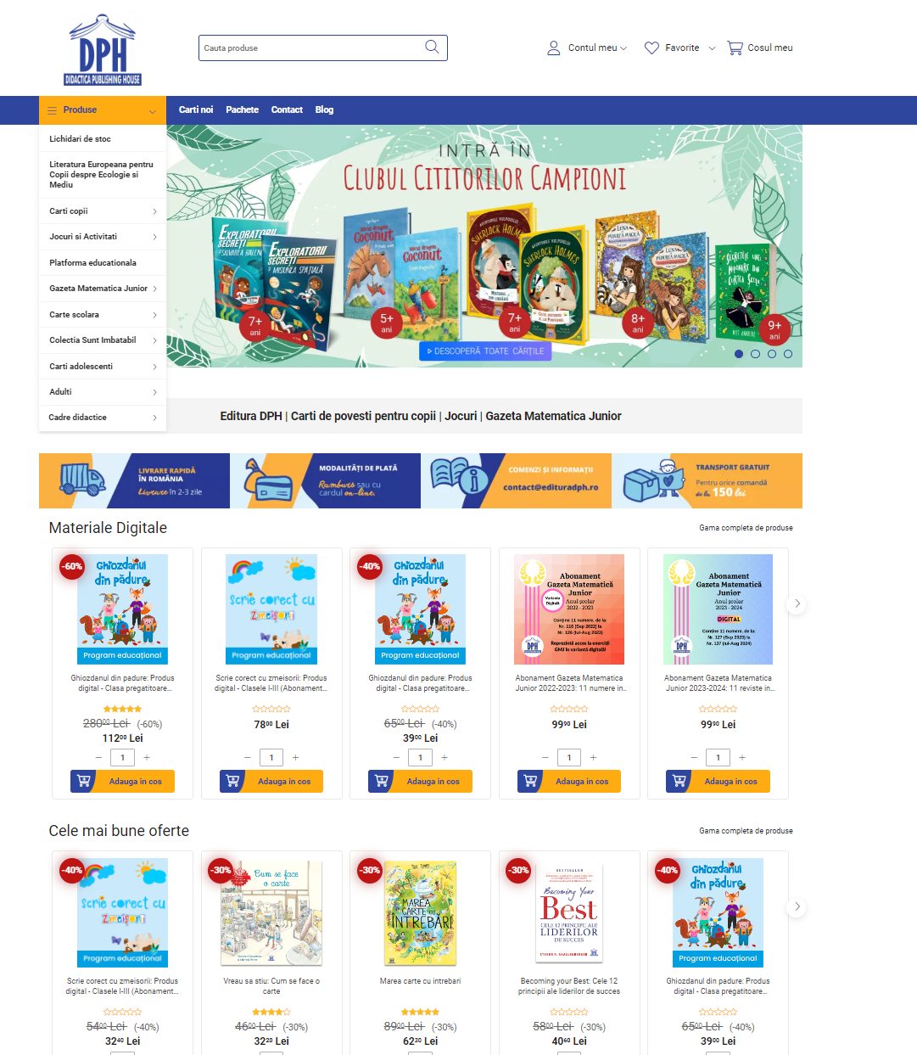
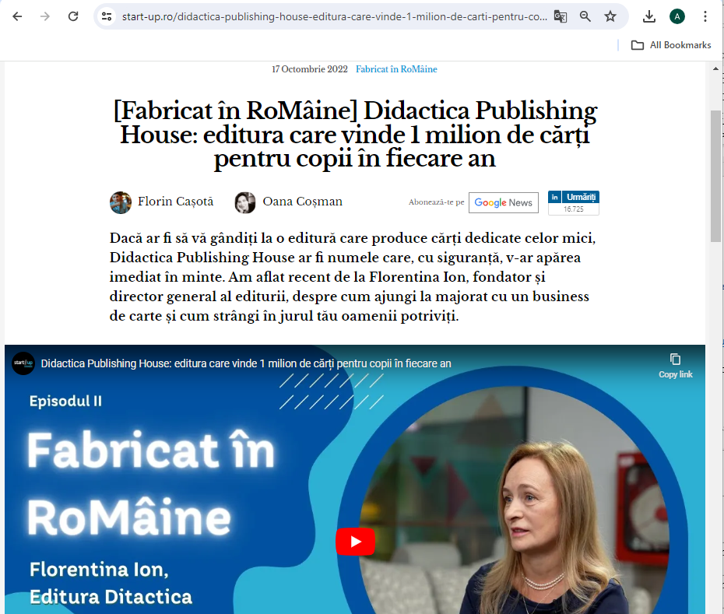
The tested product, www.edituradph.ro, is an e-commerce website that allows the customers to browse and purchase different products.
In total, the publishing house's portfolio includes over 2,000 titles.
Didactica Publishing House ended 2021 with a turnover of almost 3.2 million euros. 2022 brought a balance between online and offline sales and an increase in sales through own channels, which accounted for 30% of total sales.
Main functionalities:
Create account
Login
Browse products
Shopping cart functionalities
Checkout
Add a product review
Add to favorites
Track an order
Change personal informations

Slide 3
How did you approached testing?
I tested the application from the point of view of an end user AND from the point of view of a junior tester (inevitably I also tested scenarios that a user would not do).
I started with exploratory testing.
Then I tested the entire application, each functionality separately.
Then I started writing the test cases and reporting the bugs I had already found and this made me pay even more attention to every detail, so I found new scenarios to test and new bugs.
In the end, I did the non-functional testing and the automatic testing of several flows.

Slide 4
Tools used:
Test Cases | TestLink
Bug reporting | Mantis
Automated tests | Selenium

Slide 5
Testing types covered
Manual Testing
Automation Testing
Functional Testing
Non-Functional Testing
Security Testing
Compatibility Testing
Usability Testing
Smoke Testing
End-to-End Testing
UI Testing
Exploratory Testing
Positive Testing
Negative Testing

Slide 6
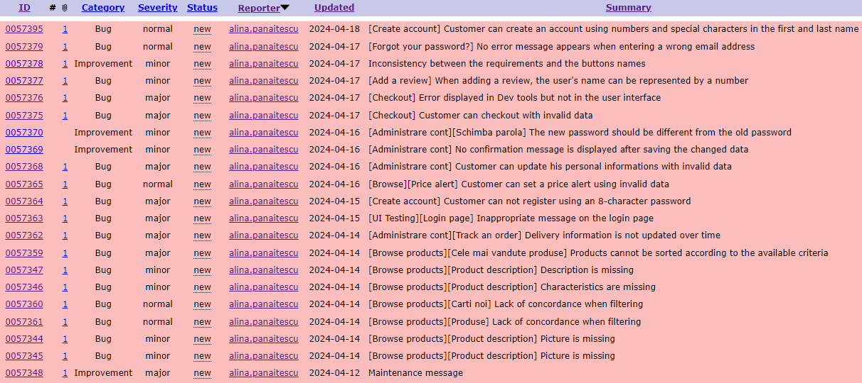
Bugs over view:
improvements – 4
bugs – 19
major – 9
normal – 5
minor – 5

Slide 7
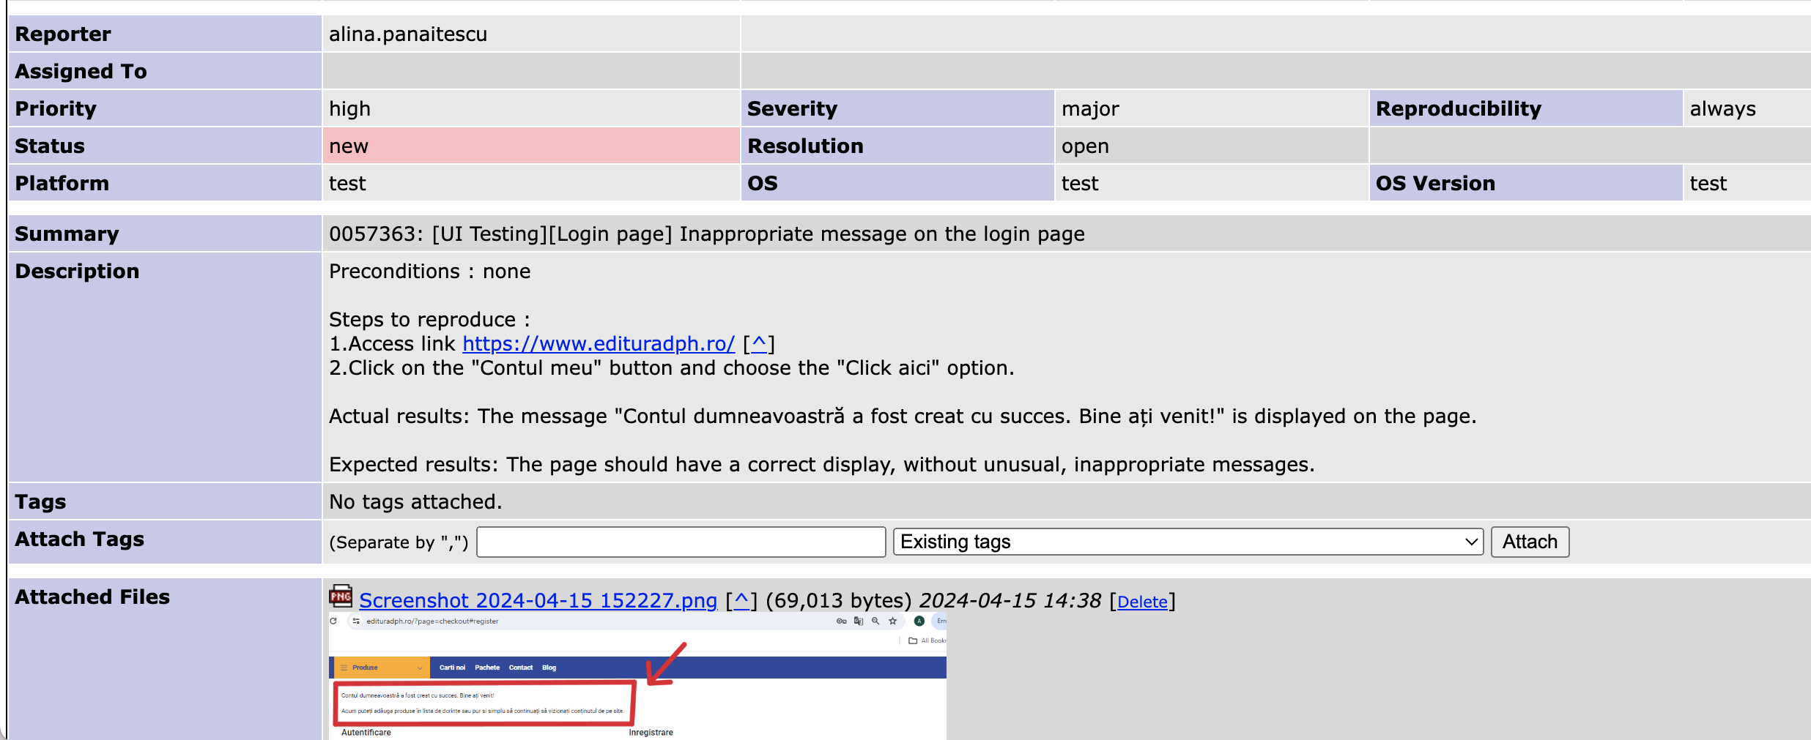
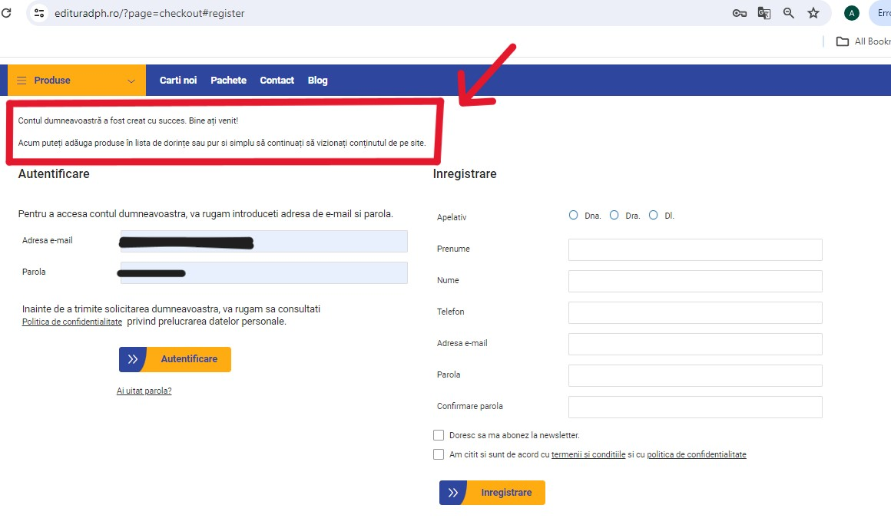
Bug e.g. : Inappropriate message on the login page

Slide 8
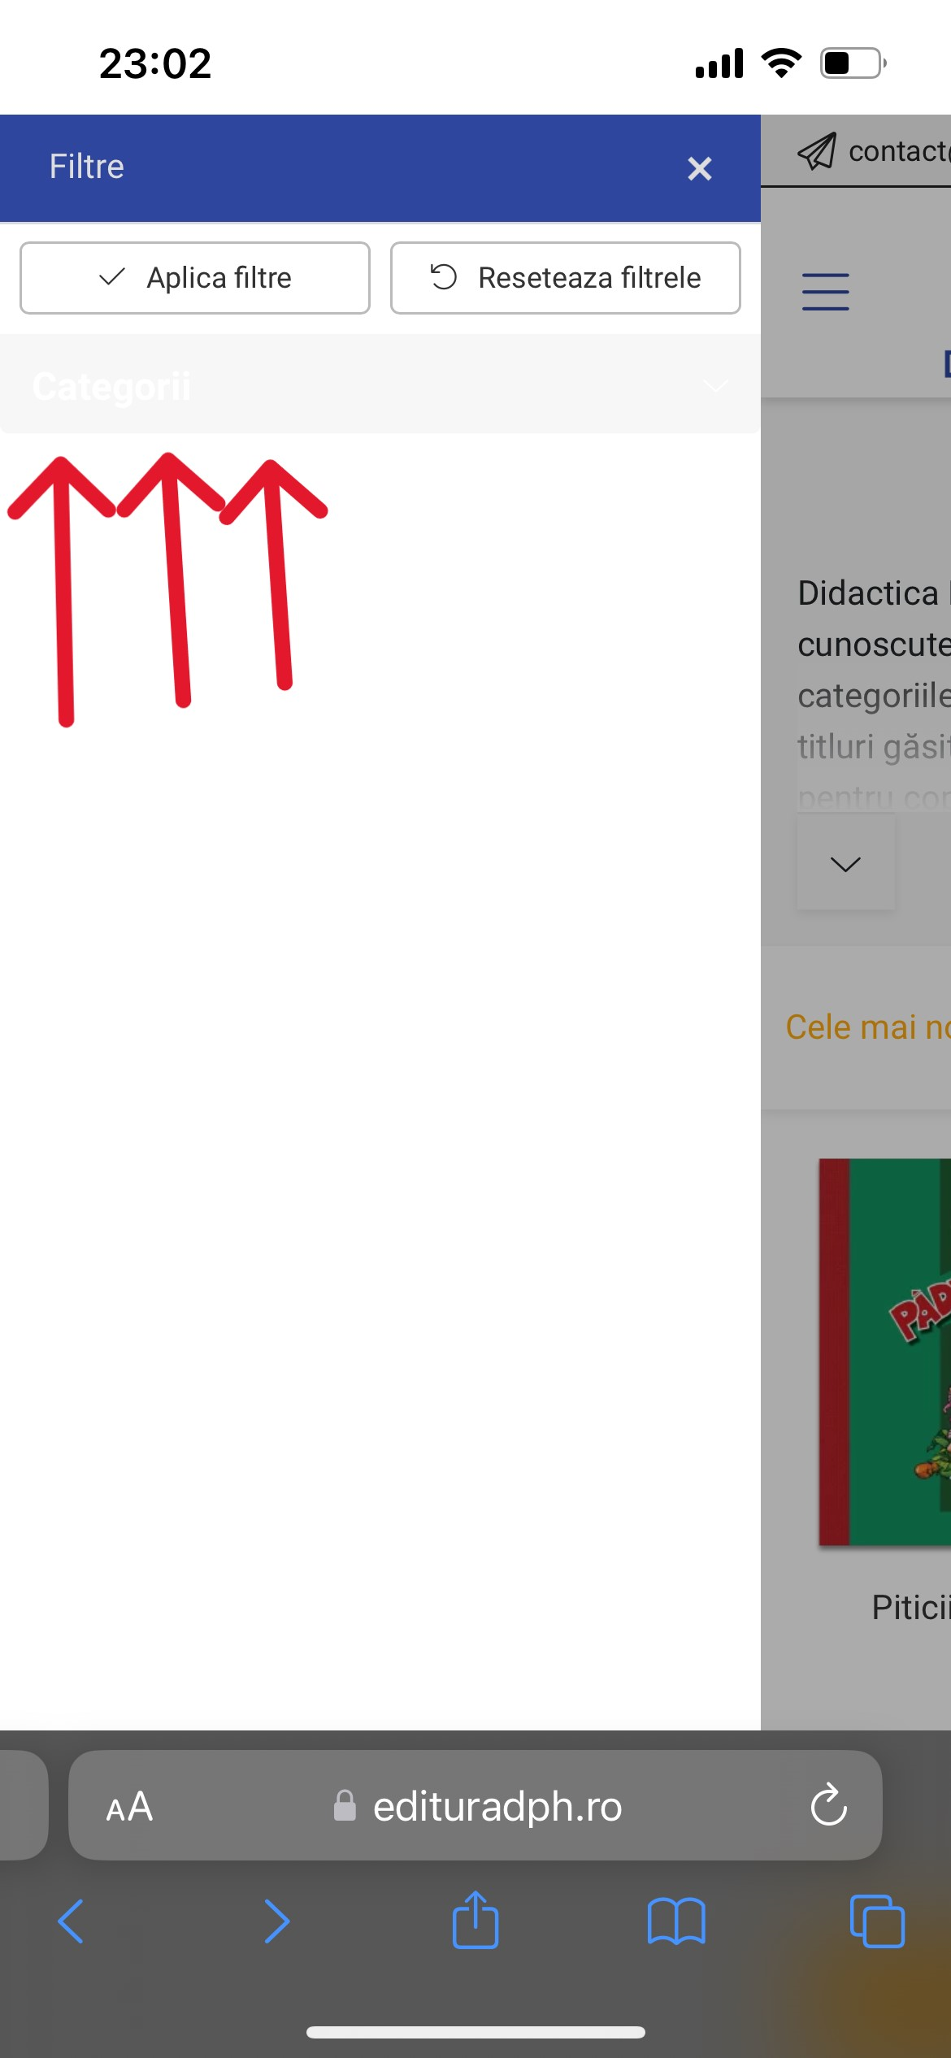
Bug e.g. : Sort by button it is slightly visible (written in white on a light gray background)

Slide 9
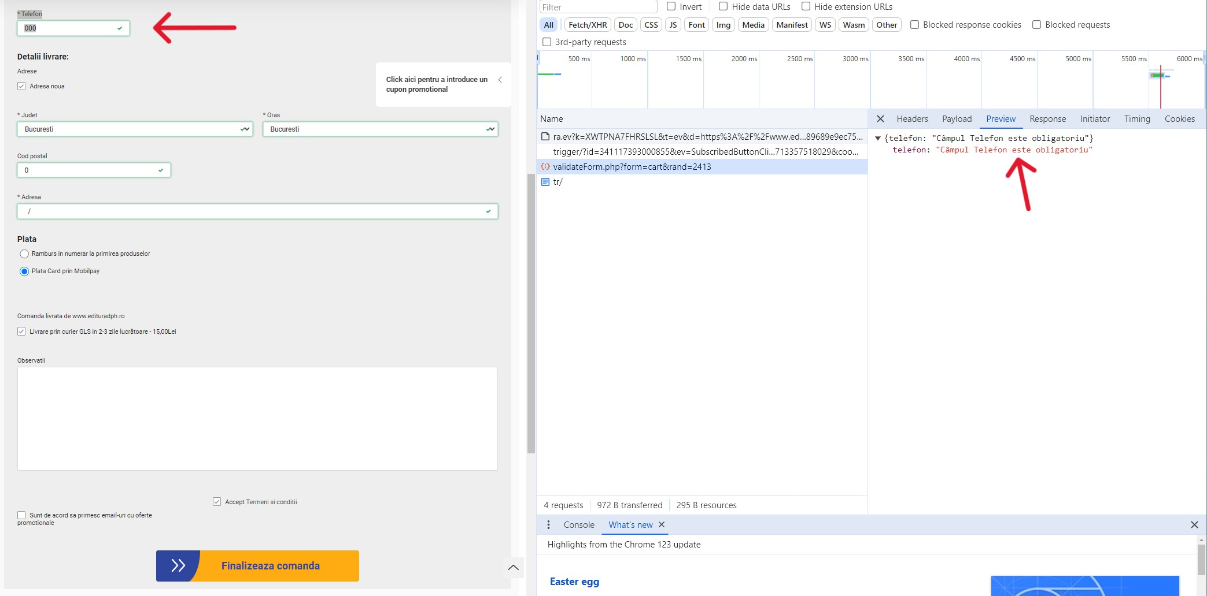
Bug e.g. : Error displayed in Dev tools but not in the user interface

Slide 10
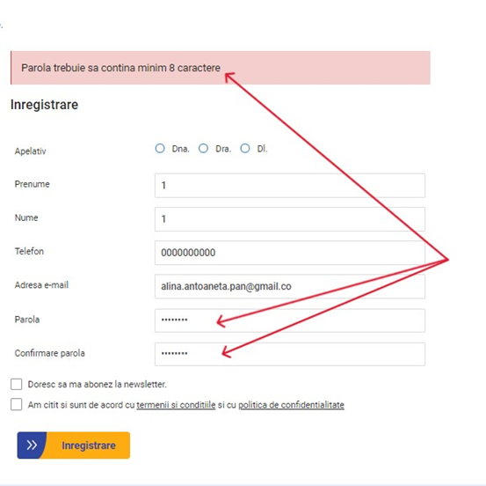
Bug e.g. : Customer can not register using an 8-character password

Slide 11
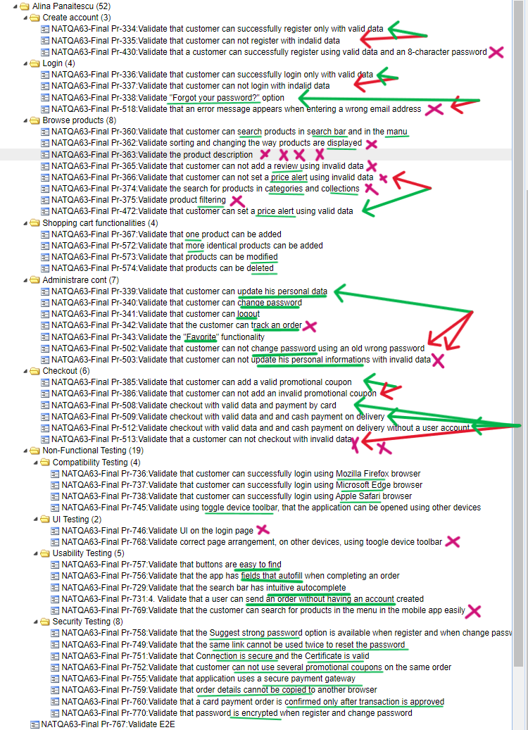
Test cases over view: total test cases : 52 functional testing : create account : 3 login : 4 browse products : 8 shopping cart functionalities : 4 administrare cont : 7 checkout: 6 non-functional testing : 19 compatibility testing : 4 UI testing : 2 Usability Testing : 5 Security Testing : 8

Slide 12
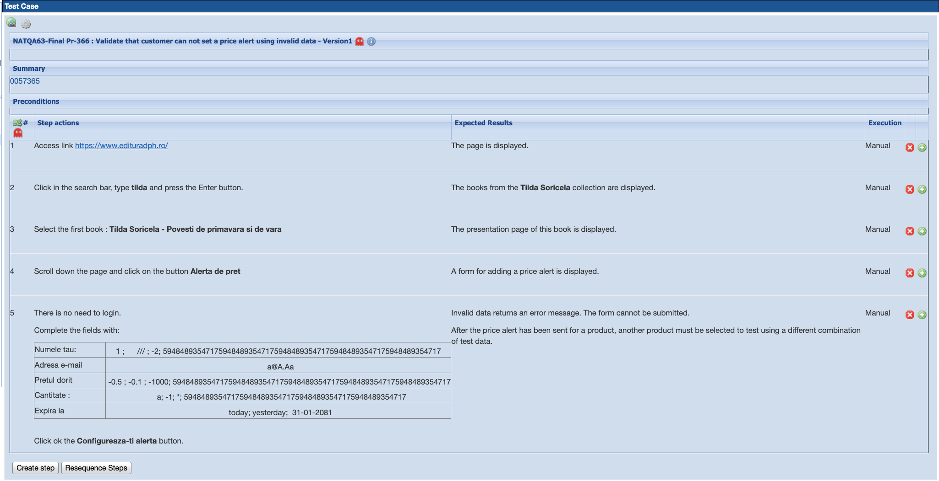
Test case e.g. :

Slide 13
Test cases results:
Total test cases : 52
Tests passed : 38
Tests failed : 14 => Bugs : 19

Slide 14

Automated test:

Slide 15
Conclusions/test report:
The application is good. Apart from the 3 bugs that I presented earlier, the rest are minor or do not affect them directly or it is unlikely that such a situation will occur.
I think that an important improvement that could be brought is the rethinking of the product menu and the classifications, and the interface for mobile browsers.I think that many customers prefer to use the mobile application, and the clearer visualization of the classification of products in categories would help the user to find what they are looking for more quickly.

Slide 16
Lessons learned:
I learned that sometimes even though you prepare for a deadline so that you have enough time, as you move forward with the execution, you realize new and new details, which you did not foresee initially. So that in the end, you still end up finishing the project very close to the deadline.
Time management is just as important as the execution of the technical part of the project!
But at least, you are more satisfied with what you managed to do, because you had more time at your disposal.

